Slide 1
Tahirih Pro Bono Network Virtual Open House
November 29, 2022

Slide 2
Today’s Presenters
Payal Sinha, Managing Attorney (Bay Area Office)
Rachel Sheridan, Litigation Counsel (Bay Area Office)
Collin Mickle, Managing Attorney (Atlanta Office)
Anusce Sanai, Managing Attorney (GDC-B Regional Office)
Adilene Nunez Huang, Co-Director of Client Advocacy, Legal Services (Falls Church Office)
Today’s Presenters| tahirih.org

Slide 3
Agenda
Welcome
Introduction to Tahirih and our Impact
Our Unique Pro Bono Program
How to Get Involved
Questions/Contact Information
Agenda| tahirih.org

Slide 4
Introduction to Tahirih and our Impact

Slide 5
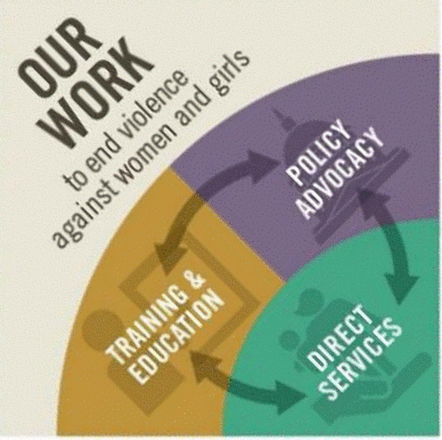
Who we are
25 years of service as a Bahá’í inspired organization
Our mission: serve immigrant survivors of gender-based violence
One client services team working together with the client leading
Our three-pronged approach to ensuring immigrant survivors of violence can live in safety and with dignity
Introduction to Tahirih and Our Impact| tahirih.org

Slide 6
Our work
Types of Tahirih Cases
Asylum
U visa
T visa
VAWA
SIJS
Affirmative (USCIS)
Defensive (Immigration Court)
Appeals
Litigation
Introduction to Tahirih and Our Impact| tahirih.org

Slide 7
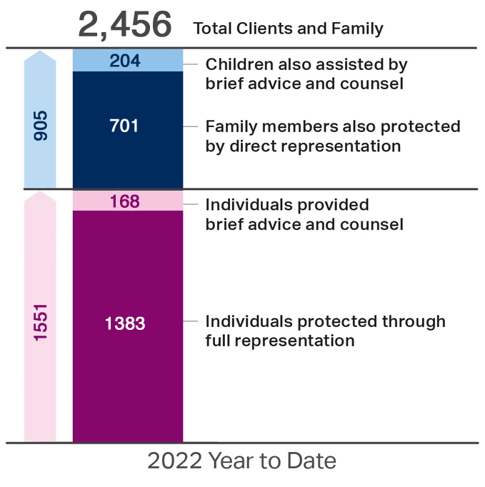
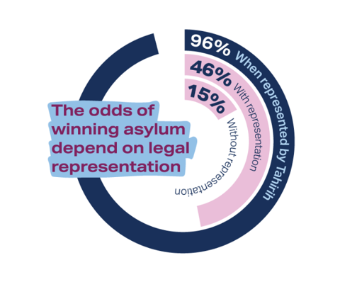
Our impact
Introduction to Tahirih and Our Impact| tahirih.org

Slide 8
Our Unique Pro Bono Program

Slide 9
Our pro bono partnership model
The Co-Counsel model
Nearly 2,000 individual pro bono attorneys in our network
56% cases currently co-counseled
Clients retain access to social services
Tahirih and Pro Bono Firm execute a co-counsel agreement prior to placing a matter
Benefits to the pro bono attorney
Work directly with clients
Hands-on mentorship by experts in the field and access to samples and templates
Expansion of litigation and legal writing skills
Our Unique Pro Bono Program| tahirih.org

Slide 10
What does co-counseling look like?
Kick-off call with the Tahirih Mentor
Ongoing strategy conversations
Review of documents and deadlines
Support with witness preparation
Support with interview preparation
Mock hearing/interview
Access to in-house social services support for clients
Training on the subject matter for all interested attorneys
Training on Trauma Informed and client centered lawyering
Special Summer Associates Projects available
Short term project related to specific matters available
Our Unique Pro Bono Program| tahirih.org

Slide 11
How to get involved

Slide 12
Litigation and Policy Advocacy
Appeals: administrative/judicial
Impact litigation
FOIA work
Regulatory comments
Amicus briefing
Please reach out to Rachel Sheridan if interested: rachels@tahirih.org
How to Get Involved| tahirih.org

Slide 13
San Francisco Opportunities
J, a 31-year-old citizen of Guatemala, has suffered domestic violence in his past relationship where the abusive partner attempted to assault him with a knife. Due to the ex-partner’s severe anger issue, children were taken away from her and arrest was made. The ex-partner also sent sever threats and sent a group of men to assault J. The threats continue and she continues to stalk J and his family. J and his daughters finally fled to the United States and are currently in a removal proceeding with an individual hearing scheduled on May 20, 2024, at the San Francisco Immigration Court. J will need assistance with country conditions expert witness, and a psychological evaluation. J, a Spanish speaker, will need an interpreter.
How to Get Involved| tahirih.org

Slide 14
San Francisco Opportunities
G, a 17-year-old, citizen of Guatemala was subjected to (multiple) sexual assault, physical abuse, and emotional abuse in the form of insults and threats by her uncle. She decided to flee to the United States in May 2021, from fear that the uncle would kill her. G survived sexual assault by her half-brother in the United States, whom she stayed with after being released from the ORR custody. She reported the sexual assault to Daly City Station and has cooperated with the law enforcement. G is eligible for U Visa. G, a Spanish speaker, will need an interpreter. G will need assistance with a psychological evaluation. G will also need representation in the Affirmative Asylum filing while Tahirih is currently working on skeletal application to avoid any further delay. G has missed one year filing deadline; however, she may be able to argue the extraordinary circumstances exception.
How to Get Involved| tahirih.org

Slide 15
San Francisco Opportunities
N, a 40-year-old, citizen of Mexico who came to the United States with her ex-partner in October 2005. N’s ex-partner became physically abusive throughout their 10-year relationship and sexually molested their minor daughter in the United States. N has reported the incident to Redwood City Police Department. N needs assistance in completing a U visa application and a psychological evaluation for herself and both children. N prefers to work with female attorneys, speaks Spanish, would need an interpreter.
How to Get Involved| tahirih.org

Slide 16
San Francisco Opportunities
More SF Office Case Opportunities can be found at Paladin Platform or by emailing Payal at payals@tahirih.org, and our periodic Newsletter. If you are not a receiving ProBono Newsletter, please contact us.
Our upcoming project include:
1. Country Condition Research (Mexico, Guatemala, El Salvador) -The research focus on written documents that help explain the danger and lack of protection in these country for survivors of gender-based violence; include reports from human rights organizations, newspaper articles, or government publications that can be used to explain the circumstances that exist in the country of origin. (Opportunity for Non- Attorneys/Attorneys)
2. Employment Authorization Clinic – Assisting clients with renewing their application for work authorization and filing fee waiver application. (Opportunity for Non-Attpornys/Attorneys)
How to Get Involved| tahirih.org

Slide 17
San Francisco Opportunities
3. Adjustment of Status Clinic: Assisting clients in preparing application for permanent residency, that would provide them a path to citizenship and family unification. (Opportunity for Attorneys)
4. U Visa Application Assistance Clinic: Assisting victims of crime in applying for Immigration remedy with USCIS in affirmative form, that would provide them an opportunity for work authorization, driver licenses, social security and a path to residency in the United States. (Opportunity for Attorneys and Non Attorneys- team)
5. VAWA Self Petition Application Assistance Clinic- Assisting victims of domestic violence by an abusive US Citizen/ LPR spouse or child or parent by filing affirmative relief at USCIS, allowing such survivors a path free from violence (Opportunity for Attorneys and Non Attorneys- team)
How to Get Involved| tahirih.org

Slide 18
Atlanta Opportunities
G is a 28-year-old citizen of Honduras who fled to the United States with her husband and two daughters in August 2021, after a relative was killed by gang violence. G's husband had been physically abusive toward her throughout their 8-year marriage, including after the family arrived in the Atlanta area. In October of 2021, G's husband sexually assaulted both of their daughters. G and her daughters took refuge with a neighbor, called the Atlanta Police Department and reported the crime. The perpetrator is still a fugitive. G is in immigration proceedings but does not yet have a master calendar hearing date set. G received certification of her U visa case in November 2022. G needs assistance in completing a U visa application and will also need representation in removal proceedings, including a country conditions expert witness and a psychological evaluation for herself and both children. G prefers to communicate in Spanish.
How to Get Involved| tahirih.org

Slide 19
Atlanta Opportunities
D is a 28-year-old citizen of Jamaica. D identifies as a lesbian. She fled to the United States in May of 2022 after being sexually assaulted by her supervisor at work. She had previously suffered multiple physical assaults and threats of sexual violence from men claiming they would "fix" her sexuality. She relocated multiple times within the country seeking a safe place to live, but was persecuted and threatened wherever she went. She reported her sexual assault to the police, who took no action. D states that it is not safe for her to return to Jamaica, as the police refuse to protect queer women from identity-related violence. D is in removal proceedings, with a master calendar hearing date of April 11, 2024. She needs assistance with applying for asylum prior to the one-year anniversary of her arrival in the United States, as well as representation in removal proceedings.
How to Get Involved| tahirih.org

Slide 20
Greater DC-Baltimore Opportunities
C, a 32-year old citizen of El Salvador survived child sexual abuse by her half-brother and severe domestic violence from her former partner in El Salvador. C’s ex-partner attempted to kill C in 2021, which resulted in a criminal proceeding against him in El Salvador. C continued to receive threats of death from her ex-partner and fled to the U.S. in late 2021. Upon arriving to the U.S., C and her daughter were trapped in a labor trafficking situation by C’s cousins and aunt, who forced C and her daughter to sleep on the floor of a laundry room, denied them ability to regularly bathe, and insulted and threatened them while forcing C to work to pay off a $16,000 debt paid for C and her daughter’s journey to the U.S. C needs assistance with applying for a T-Visa and due to her victimization in the U.S. C will also need representation in the Affirmative Asylum filing and the possible consequence of an EOIR referral. Tahirih is vetting the matter for further clarity in strategy. C’s daughter will need representation in removal proceedings should her NTA be filed with the Immigration Court. C prefers to work with female attorneys. We believe C will need a country conditions expert witness, and a psychological evaluation. C, a Spanish speaker, will need an interpreter. C will also require financial assistance for transportation to meet with the legal team in Falls Church or DC.
How to Get Involved| tahirih.org

Slide 21
Greater DC-Baltimore Opportunities
SHORT TERM PROJECTS
Affirmative Asylum- Country Condition Research for FGM in Kenya: Client a young citizen of Kenya, highly educated and an uncut woman, was sent to the United States to attend a conference as an excuse to escape her grandfather who had begun to make plans for her circumcision in anticipation of her forced marriage to a 76-year-old man who already has three wives. Client's matter needs assistance with completing the documents necessary for her affirmative asylum matter currently pending with the Asylum Office in Arlington, VA.
Pre-Hearing Brief Draf for Defensive Asylum Case (pending): Hearing is set for March 20, 2023 in the Baltimore Immigration Court. Client was raped by her father in Honduras and had a child by him. She also spoke out against the gangs who have since attacked and severely injured that child. Client's one year deadline has passed but there is a changed circumstances argument based on her father’s death threats in the U.S. and his departure back to Honduras. The Tahirih attorney needs assistance in the drafting of the pre-hearing brief (first draft review needs to be on 01.15). All evidence is already collected. Sample briefs available
How to Get Involved| tahirih.org

Slide 22
FIND OUR OPPORTUNITIES ON PALADIN
Follow this link to see the listed opportunities
and to express an interest.
https://app.joinpaladin.com/tahirih-justice-center-2/opportunities
How to Get Involved| tahirih.org

Slide 23
Thank you!

Slide 24
Reach Out to Us
Payal Sinha (San Francisco): payals@tahirih.org
Rachel Sheridan (Litigation): rachels@tahirih.org
Collin Mickle (Atlanta): collinm@tahirih.org
Anusce Sanai (Greater DC-Baltimore): anusce@tahirih.org
Adilene Nunez Huang (Falls Church): adin@tahirih.org
Contact us | tahirih.org

