Slide 1
2020 in Review, Preparing for 2021
Pro Bono Network Webinar
December 16, 2020

Slide 2
Today’s Presenters
Tahirih National Office
Rená Cutlip-Mason Chief of Programs
Richard Caldarone Litigation Counsel
Tahirih XXXXXXX Office
Name
Title
Title
Tahirih Pro Bono Network Webinar | tahirih.org

Slide 3
Agenda
Welcome Introductions
COVID-19 Updates Agency updates, guidance, practice tips
Other Legal Updates Case law, administrative, litigation
2020 in Review
Looking Forward to 2021
Questions
Pro Bono Network Webinar | tahirih.org

Slide 4
Learning Objectives
TODAY’S OBJECTIVES:
1
2
3
Pro Bono Network Webinar | tahirih.org

Slide 5
COVID-19 UPDATES

Slide 6
Agency Operating Status
Tahirih updates its Pro Bono e-Library every day when there is a relevant agency update.
Agency | Status
EOIR- Detained Hearings | Open
EOIR- Non-detained & MPP | Postponed through October 30, 2020 Arlington, Atlanta, Baltimore, San Francisco courts open
USCIS | Open
ICE ERO | Suspended or Telephonic
State | Routine Visa Interviews Suspended
COVID-19 Updates| tahirih.org

Slide 7
Immigration Courts
Subject
Details
Details
Subject
details.
COVID-19 Updates| tahirih.org

Slide 8
Board of Immigration Appeals
Subject:
Details
COVID-19 Updates| tahirih.org

Slide 9
USCIS
Subject
Details
Subject
Details
COVID-19 Updates| tahirih.org

Slide 10
COVID-related litigation
Cases seeking release from detention
Individual successes;
Modest results in system-wide cases, mostly rulings requiring compliance with CDC guidance rather than release
Cases challenging COVID policies
Ongoing against EOIR, USCIS
No major rulings yet
Litigation contemplated re: border closure
COVID-19 Updates| tahirih.org

Slide 11
Impact on Clients
Updates
COVID-19 Updates| tahirih.org

Slide 12
OTHER LEGAL UPDATES

Slide 13
Immigration Law & Policy Updates
Case updates:
Latest Updates | tahirih.org

Slide 14
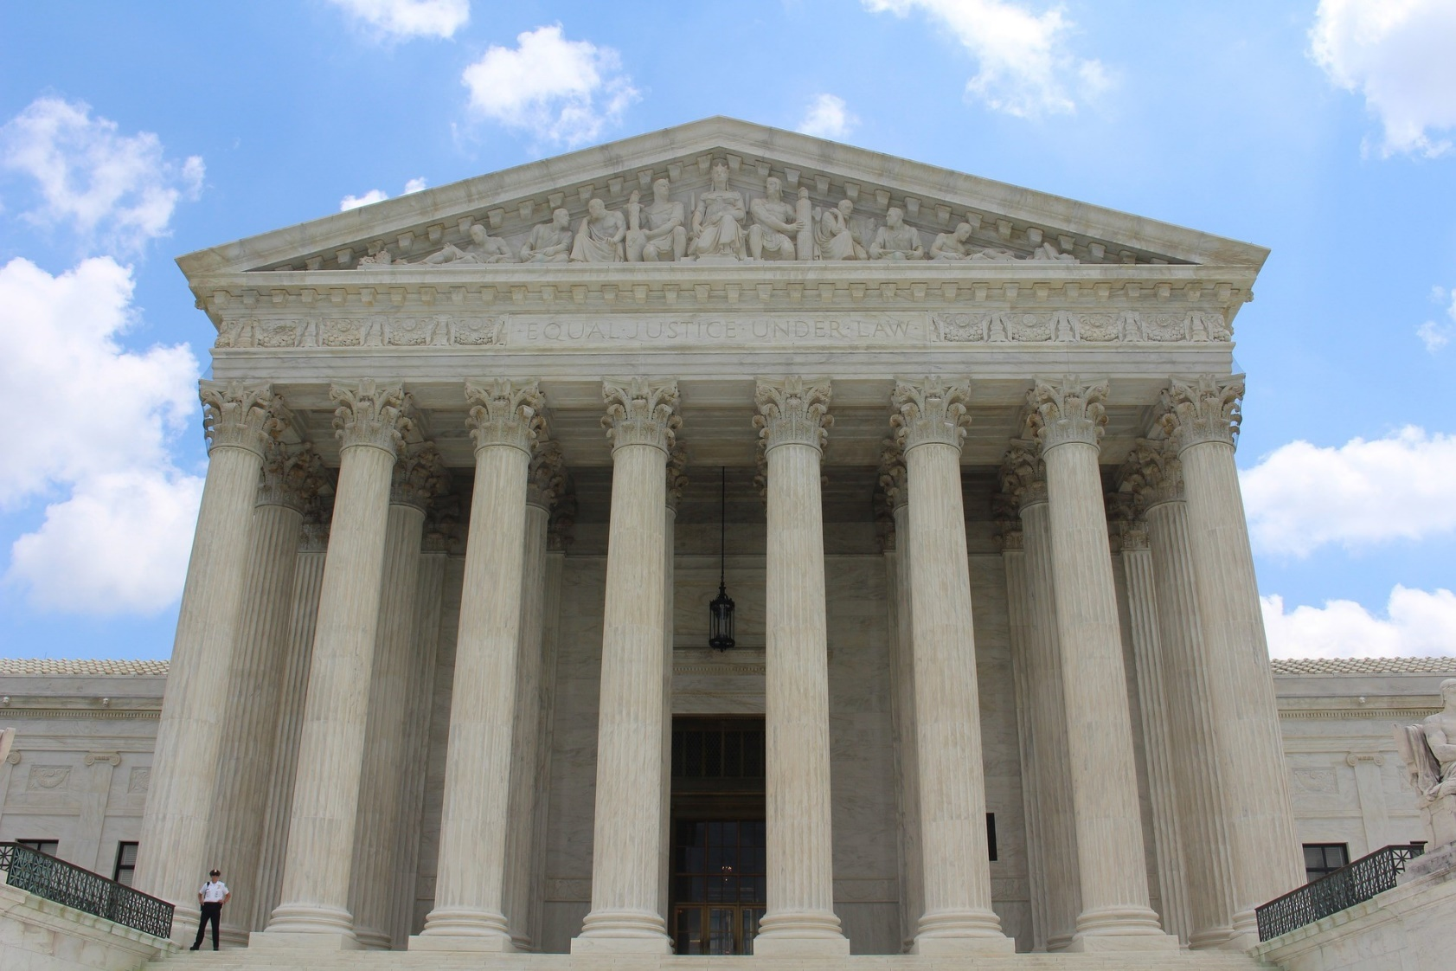
Supreme Court Update
Case Title or Subject
Takeaway
Takeaway
takeaway
Latest Updates | tahirih.org

Slide 15
The _____Circuit
Case Name (Number)
Holding
Takeaway
Duplicate this slide as needed
Case Name (Number)
Holding
Takeaway
Latest Updates | tahirih.org

Slide 16
The _____Circuit
Case Name and Cite
Use this slide if there’s only one case
Latest Updates | tahirih.org

Slide 17
BIA
Case Cite
Details/takeaways
holding
Case Cite
Details/takeaways
holding
Latest Updates | tahirih.org

Slide 18
BIA
Case Name and Cite
Use this slide if there’s only one case
Latest Updates | tahirih.org

Slide 19
Tahirih Litigation Update
Case Name and Cite
Key details summary
Procedural posture
Latest Updates | tahirih.org

Slide 20
Tahirih Litigation Updates
Case Cite
Use this slide if there are multiple cases to update
Case Cite
Use this slide if there are multiple cases to update
Latest Updates | tahirih.org

Slide 21
Regulatory Update
Subject
Key details summary
Procedural posture
Use this slide if there’s only one
Latest Updates | tahirih.org

Slide 22
Regulatory Updates
Subject
Key details summary
Procedural posture
Use this slide if there are multiple updates
Subject
Key details summary
Procedural posture
Use this slide if there are multiple updates
Latest Updates | tahirih.org

Slide 23
SUBSTANTIVE SEGMENT TITLE

Slide 24
Subsection (Text and Box)
Introductory information about the section on which you are presenting. This text box can be two lines in length. The font is Franklin Gothic Medium.
CALL-OUT BOX HEADING (Franklin Gothic Demi Condensed):
This is a bullet point for brief content in a list format
The font is Franklin Gothic Book size 17, and you should not click “bold” if you want to emphasize a word or phrase
Instead, change the font of the word or phrase you want to emphasize to Franklin Gothic Medium
Be sure to be consistent with or without the inclusion of periods in bulleted lists
Make sure you have proper padding/open space around all edges of your text box
2020 in Review, Preparing for 2021| tahirih.org

Slide 25
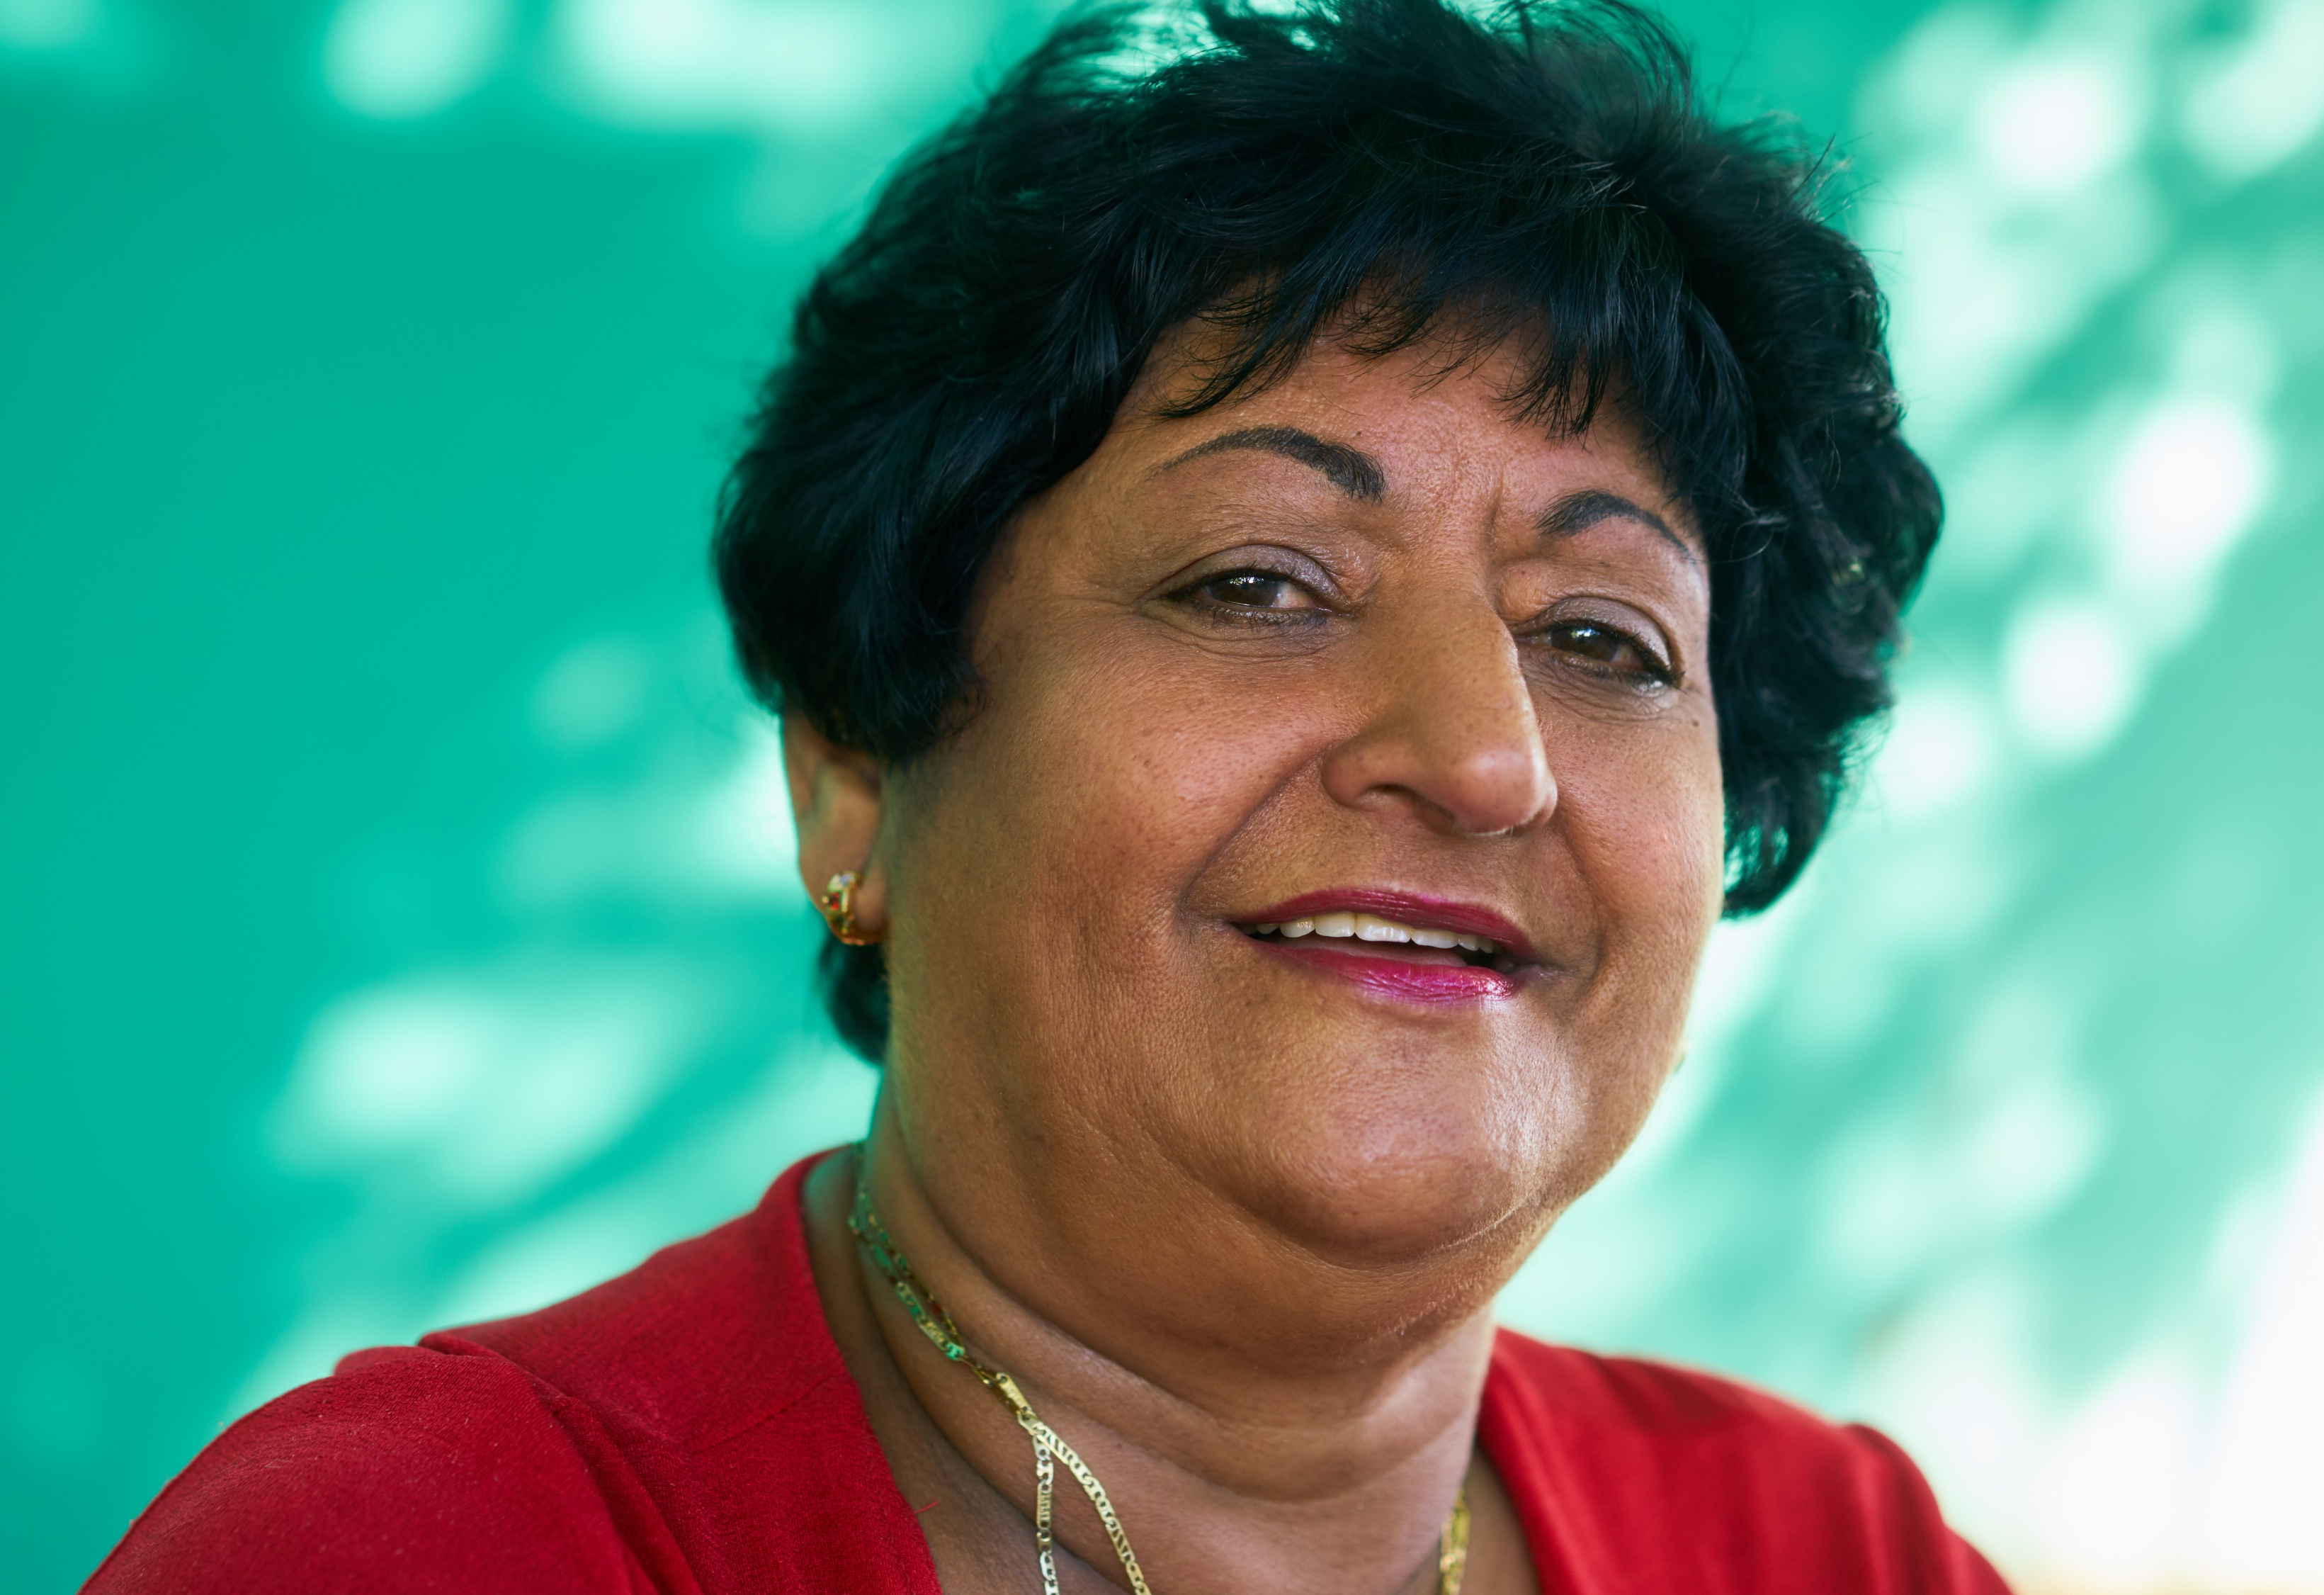
Subsection (Image and Box)
CALL-OUT BOX HEADING:
To change the image, click on it, then select Picture Tools Format in the toolbar
Select Change Picture and choose From a File … and upload your image
You may need to adjust the crop to make it fit better on the page
If you need to make the image bigger, always use the handles in the corners of the image, never along the sides
2020 in Review, Preparing for 2021| tahirih.org

Slide 26
Subsection (Two Boxes)
BOX 1 HEADING:
You can use this type of slide to compare and contrast two types of information or use it to share two similar types of information or categories. Ideally, the two blocks of information should not differ substantially in length, as that would look uneven and inconsistent. If you would like to emphasize text, use the font Franklin Gothic Medium rather than selecting “bold.” Try to keep things short and simple.
BOX 2 HEADING:
You can use this type of slide to compare and contrast two types of information or use it to share two similar types of information or categories. Ideally, the two blocks of information should not differ substantially in length, as that would look uneven and inconsistent. If you would like to emphasize text, use the font Franklin Gothic Medium rather than selecting “bold.” Try to keep things short and simple.
2020 in Review, Preparing for 2021| tahirih.org

Slide 27
Subsection (Event Details)
Date of the Event
Location of the Event
CONVENER INFORMATION
Example Name Example Title and Organization
Example Name Example Title and Organization
PRESENTER INFORMATION
Example Name Example Title and Organization
Example Name Example Title and Organization
2020 in Review, Preparing for 2021| tahirih.org

Slide 28
Subsection (Long Text)
This is a section that has plenty of space for text, which could include content from a law or policy, or perhaps a client story. Of course, the amount of text on a slide should not be too long, and you should add the full details that you would like to share in the notes section attached to each slide rather than on the slide itself.
The font is Franklin Gothic Medium size 20. This can be made larger if you plan to include less text content, but you should not make it any smaller for the sake of legibility (large blocks of text in small font sizes are not great for slideshows).
Make sure that your text boxes always have sufficient margins. If your text gets too close to the edge of the slide, it may look unprofessional, so keep that white/blank space!
2020 in Review, Preparing for 2021| tahirih.org

Slide 29
Subsection (Bulleted Text)
Here is a slide for a basic bulleted list. This could consist of goals, takeaways, or other succinct information.
It is helpful to have interactive portions of your presentations, so this could be a slide to use when asking your audience questions.
The font is Franklin Gothic Medium size 24.
Make sure there is always white space around your text boxes.
2020 in Review, Preparing for 2021| tahirih.org

Slide 30
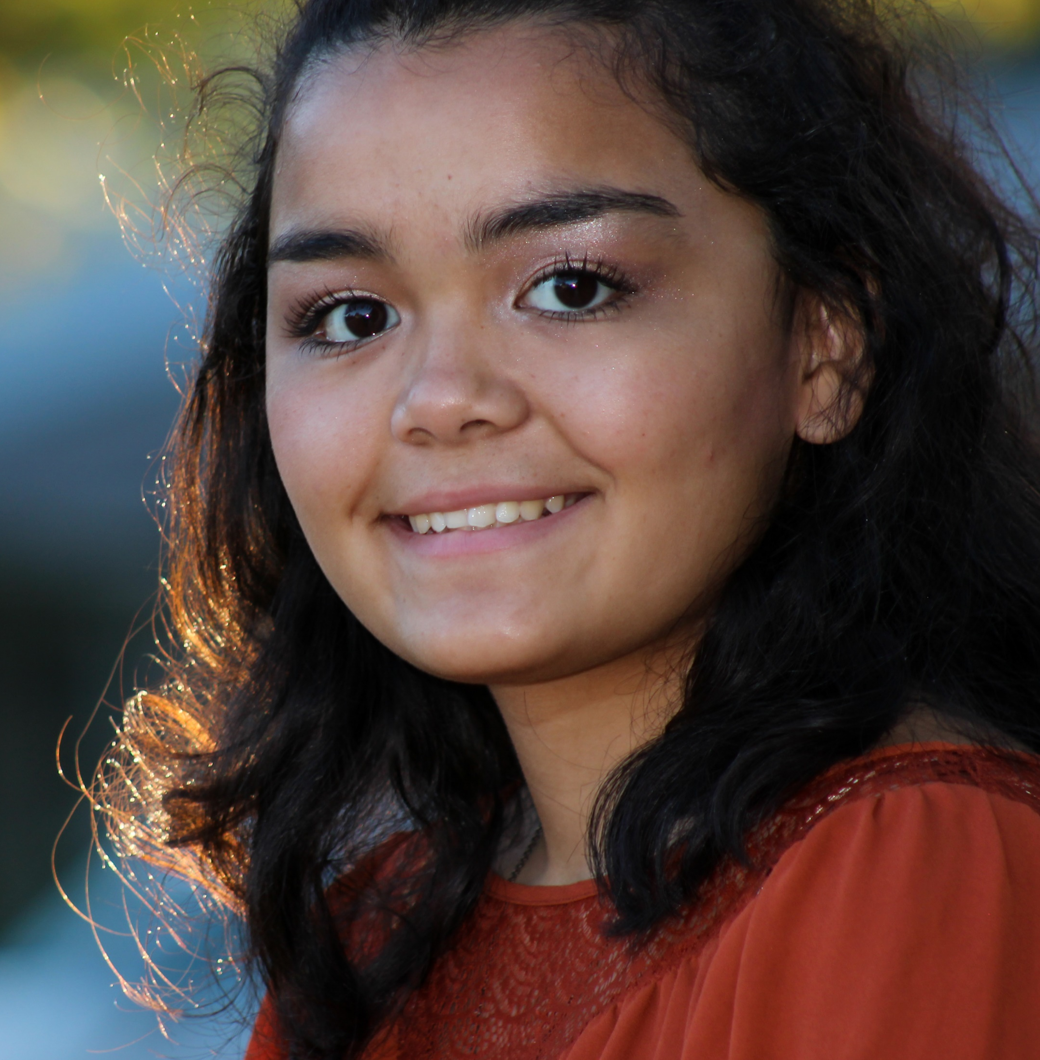
Subsection (Image and Text)
This section has space for text alongside an image, which would be useful for a client story. Of course, the amount of text on a slide should not be too long; you want your attendees to focus on you.
To change the image, click on it, then select Picture Tools Format in the toolbar. Select Change Picture and choose From a File … then upload your image. You may need to adjust the crop to make it fit better on the page.
2020 in Review, Preparing for 2021| tahirih.org

Slide 31
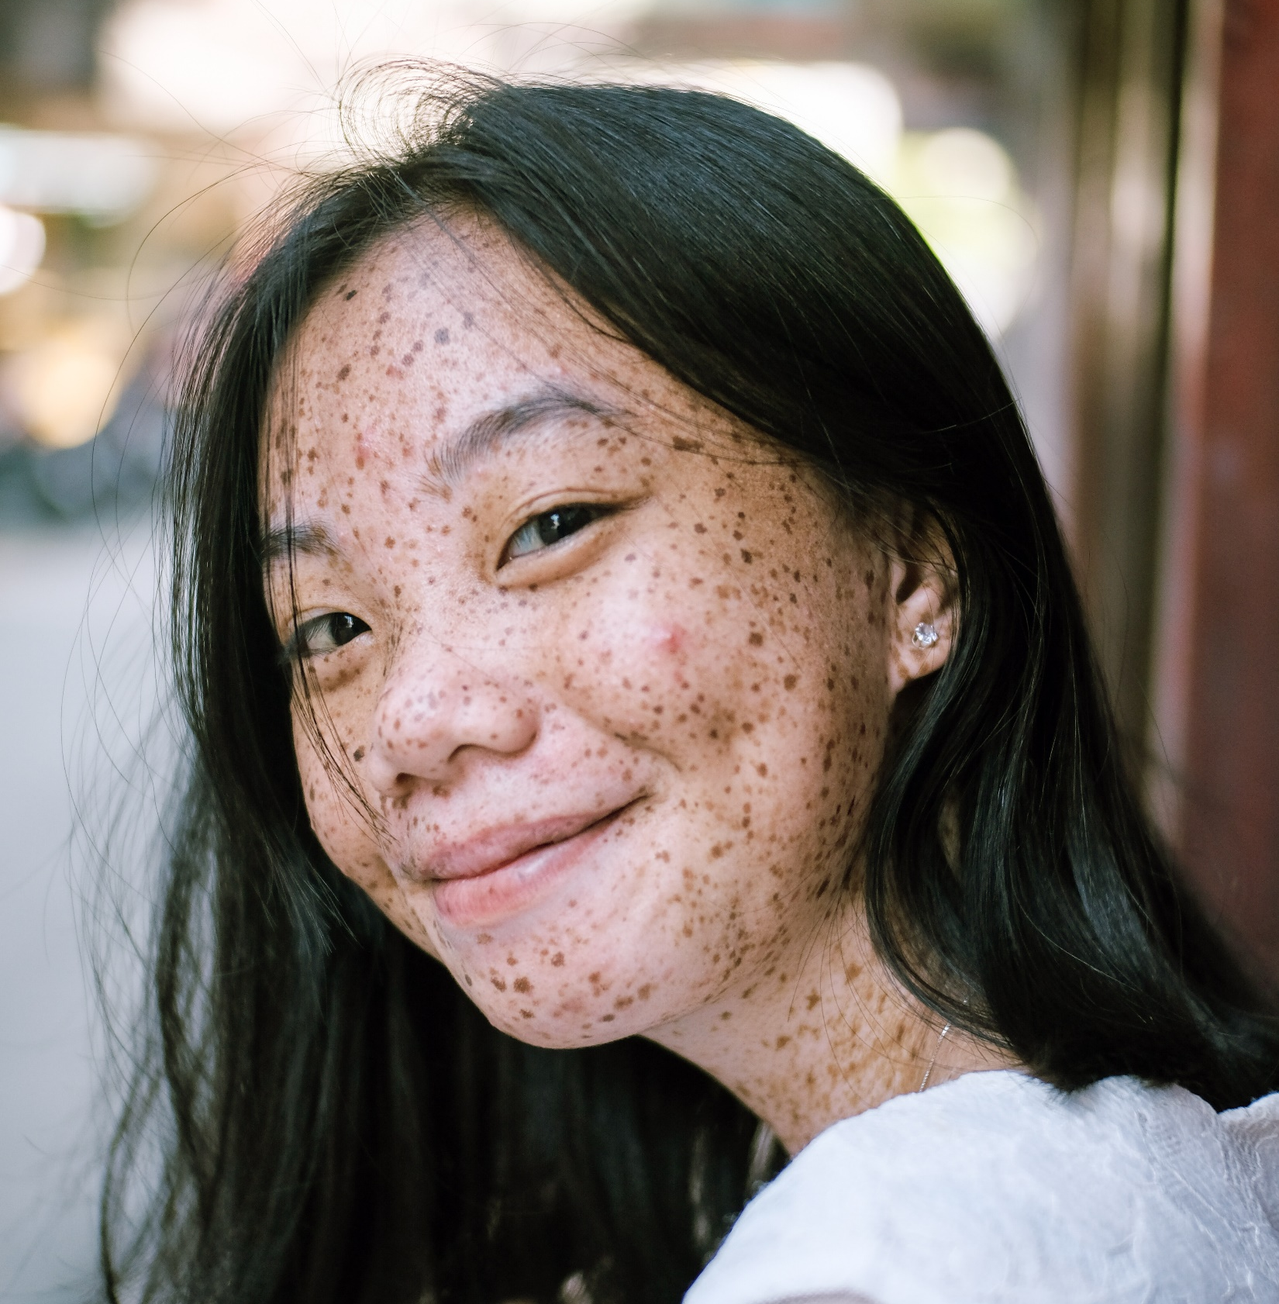
Subsection (Image and List)
Here is a slide for a basic bulleted list with a photo.
This could consist of goals, takeaways, or other succinct information.
The font is Franklin Gothic Medium size 20.
To change the image, click on it, then select Picture Tools Format in the toolbar.
Select Change Picture and choose From a File … and upload your image.
Make sure there is always white space around your text boxes.
2020 in Review, Preparing for 2021| tahirih.org

Slide 32
Subsection (Definition)
This is a section that includes information typed out in full paragraphs. It may be a good place to give a definition of a term or describe a program. However, it should still be succinct so as to not overwhelm your viewers.
The font is Franklin Gothic Medium size 24. Make sure that there is adequate padding around your text box.
TERM
2020 in Review, Preparing for 2021| tahirih.org

Slide 33
Subsection Title (Table)
Introductory information about the table on which you are presenting. This text box can be two lines in length. The font is Franklin Gothic Medium.
COLUMN | COLUMN | COLUMN | COLUMN
Data | Data | Data | Data
Data | Data | Data | Data
Data | Data | Data | Data
Data | Data | Data | Data
Data | Data | Data | Data
2020 in Review, Preparing for 2021| tahirih.org

Slide 34
Subsection Title (Bar Chart)
This is a section that includes a bar chart and a text box for a description of the chart. Be sure that the color palette of your bar chart adheres to Tahirih brand colors found in the Style Guide.*
Source: Source information can be added here as needed.
2020 in Review, Preparing for 2021| tahirih.org
Notes:
*Style Guide found here: Z:\Communications Department\Branding\Brand Book-Style Guide

Slide 35
Subsection Title (Donut Chart)
This is a section that includes a doughnut chart and a text box for a description of the chart. Be sure that the color palette of your doughnut chart adheres to Tahirih brand colors found in the Style Guide.*
Source: Source information can be added here as needed.
2020 in Review, Preparing for 2021| tahirih.org
Notes:
*Style Guide found here: Z:\Communications Department\Branding\Brand Book-Style Guide

Slide 36
Questions?
After the webinar, contact
Your Tahirih mentor attorney
justice@tahirih.org
Questions | tahirih.org

Slide 37
How You Can Help
Our work is amplified by the power of many. As Pro Bono Network members, there are many ways to contribute your time, resources, and expertise.
CO-COUNSEL
Directly represent, with Tahirih mentorship, an immigrant survivor in their asylum, VAWA, T, U visa, or Special Immigrant Juvenile Status immigration matters.
IMPACT LITIGATION
Work with Tahirih on federal litigation, amicus briefs, and other impact litigation opportunities.
ADVOCATE
Respond to our advocacy alerts to submit comments or engage in other advocacy on behalf of immigrant survivors.
RESEARCH
Help Tahirih with research and analyze legal questions or research country conditions evidence to help immigrant survivors seeking asylum and other forms of relief.
DONATE
Tahirih’s Client Fund is a pool of money that we may use to provide immediate and critical support to survivors of gender-based violence who are currently in crisis.⁠
SPREAD THE WORD
Encourage a colleague to join Tahirih’s Pro Bono Network.
How You Can Help| tahirih.org

Slide 38
Contact Us
OUR OFFICES
Atlanta
230 Peachtree Street NW
Atlanta, GA 30303
(p): 470-481-4700 | (f): 470-481-7400
atlanta@tahirih.org
Baltimore
211 E. Lombard Street, Suite 307
Baltimore, MD 21202
(p) 410-999-1900 | (f) 410-630-7539
baltimore@tahirih.org
Greater Washington, DC | National
6400 Arlington Blvd., Suite 400
Falls Church, VA 22042
(p) 571-282-6161 | (f) 571-282-6162
greaterdc@tahirih.org | justice@tahirih.org
Houston
1717 St. James Place, Suite 450
Houston, TX 77056
(p) 713-496-0100 | (f) 713-481-1793
houston@tahirih.org
San Francisco Bay Area
881 Sneath Lane, Suite 115
San Bruno, CA 94066
(p) 650-270-2100 | (f) 650-466-0006
SFBayArea@tahirih.org
Contact Us| tahirih.org

